Slide 1
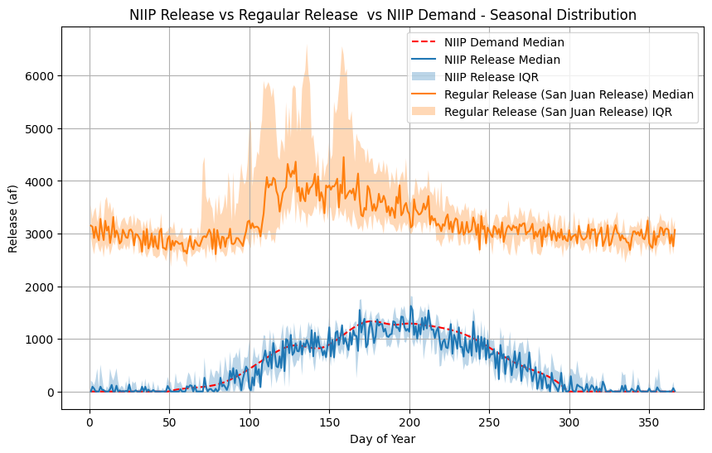
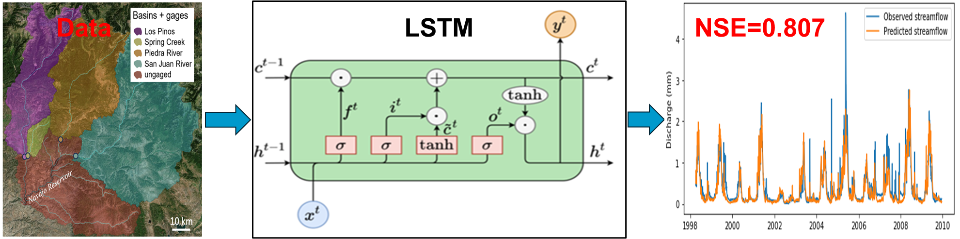
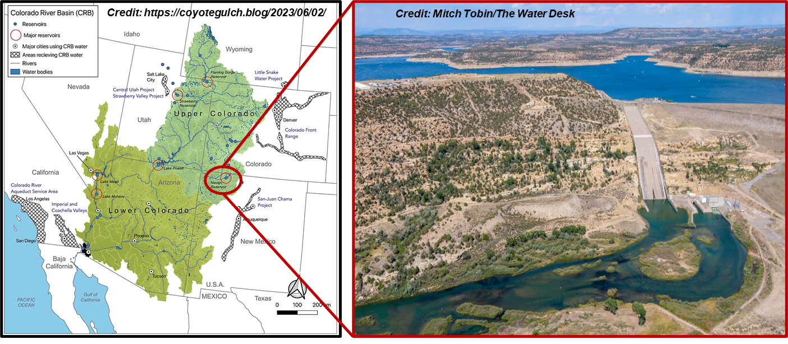
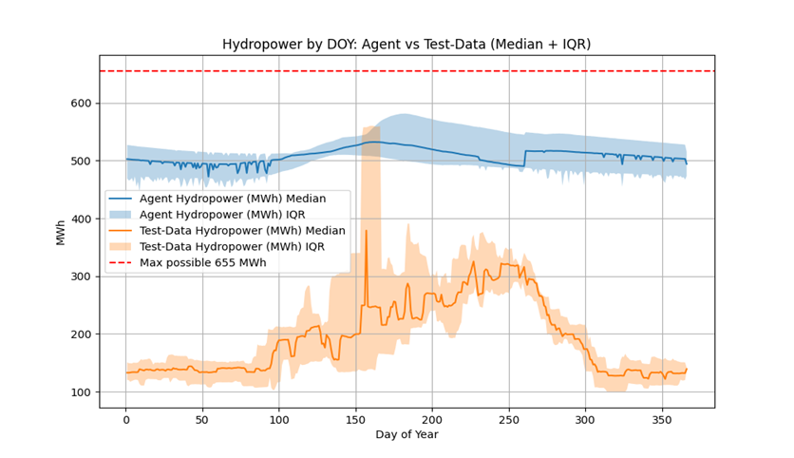
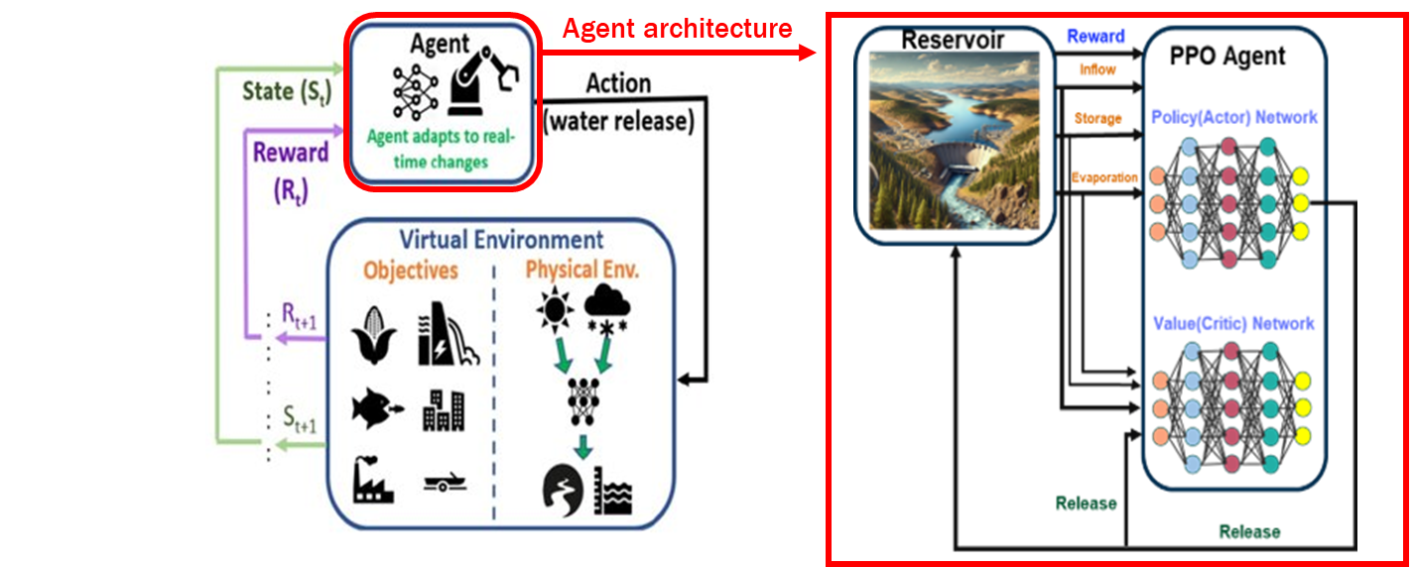
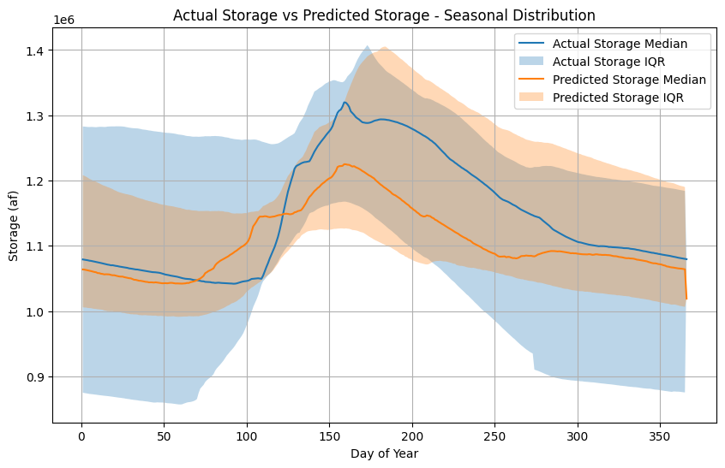
Multi-action Deep Reinforcement Learning (DRL) Agent for Optimizing Hydropower in Water-stressed Systems
Shubhendu Kumar Singh¹(shubhsingh@lanl.gov), Cristina Garcia Cardona¹, Nishath Rajiv Ranasinghe¹, Susan Behery², Katrina E Bennett¹, Jon Schwenk¹ (jschwenk@lanl.gov)
¹Los Alamos National Laboratory, ²Barr Engineering, formerly worked at USBR
INTRODUCTION
Dammed reservoirs face mounting stress from rising urban, agricultural, and energy demands. The reservoirs traditionally rely on fixed rule curves or optimization models that have provided strong foundation for reservoir operation, ensuring reliable and safe water management. Building on these advances, we propose a Proximal Policy Optimization (PPO)-based reinforcement learning (RL) framework that introduces a next-generation, adaptive control strategy that complements and extends conventional methods. By learning directly from environment interactions, PPO agent continuously refines its decisions on storage and release to respond dynamically to changing inflows, evaporation, and demand. This data-driven approach enables multi-objective optimization, balancing hydropower, water supply, and ecological needs while maintaining operational flexibility. In this work, we develop a multi-action Proximal Policy optimization (PPO) agent that simultaneously outputs two decisions-agricultural release and hydropower release while satisfying operational constraints. The result is an intelligent system that adapts in real time, enhances efficiency and resilience, and supports sustainable reservoir management under evolving hydrologic conditions .
METHODOLOGY
State (Inputs to the PPO Agent): storage, inflow (Figure 4), evaporation, day-of-year
Actions taken by the PPO Agent:
NIIP Release (Agricultural Release: Navajo Indian Irrigation Project (NIIP))
Regular Release (San Juan River Release, Hydropower Generation, Fisheries)
Constraints: storage limits, hydropower maximization, agricultural demand, fisheries sustenance
Reward: storage stability, hydropower generation, fisheries, NIIP
Algorithm: Proximal Policy Optimization (PPO) with multi-action continuous control
:
Figure 6. Seasonal distribution of NIIP Release, San Juan Release, and NIIP Demand. The PPO agent
learns distinct seasonal release behavior for San Juan release, and NIIP release. NIIP release aligns
closely with NIIP demand, while San Juan release responds to hydropower opportunities, demonstrating
coordinated multi-action learning and adaptive control
Figure 4. LSTM model for streamflow (inflow) prediction of the Navajo Reservoir. We initially trained a regional LSTM model for the Upper Colorado River Basin using more than 50 stream flow gauges and then finetuned the model for the Navajo input streams. Then, we utilized the finetuned model to predict the streamflow of the ungauged basin.
RESULTS
PPO learns realistic storage-release dynamics (Figure 5)
The PPO agent learned distinct release pattern- NIIP release follows the NIIP demand, ramping up release during peak agriculture season, while San Juan release aligns with hydropower opportunity (Figure 6)
The PPO agent maintains stable and near-optimal hydropower output (approx. 500MWh median) throughout the year (Figure 7), with narrow uncertainty (IQR) compared to that of the historical hydropower generation. The agent generates hydropower well below the physical limit (655 MWh), indicating efficient yet safe turbine utilization.
Figure 1. Navajo Reservoir
Figure 7. Hydropower Generation: The PPO agent maintains a stable hydropower output near 500 MWh (median value), significantly higher than the test data (historical hydropower generation) and with much less variability. This highlights the agent's ability to sustain efficient hydropower generation while respecting operational limits (655MWh) and hydrologic variability.
DISCUSSION & FUTURE WORK
Multi-action PPO framework successfully demonstrated its ability to learn coordinated release policy that balance hydropower generation, agricultural demand, and storage-release regulations.
The results highlight the agent's strength in capturing nonlinear, multiobjective relationship without explicit rule definitions, offering a flexible and adaptive control strategy for reservoir systems
Future work will focus on scaling the framework to multi-reservoir networks and incorporating uncertainty from climate and inflow forecasts. Additional directions include integrating economic and ecological objectives into the reward functions.
Figure 5.Predicterd storage from the PPO agent has less variability as compared to historical
storage values. The agent was able to capture the seasonal dynamics, capturing refills, and
drawdown cycles accurately. Besides, the agent effectively balances the inflows, releases,
while maintaining storage within safe reservoir limits (0.5-1.7 million acre-feet) across
hydrologic seasons.
Figure 2. Proposed DRL Framework and PPO architecture: The PPO agent interacts with a virtual environment
(Navajo Reservoir: Figure 1), learning optimal release policies. The PPO agent's actor-critic neural networks enable
adaptive, multi-objective decision-making that balances storage, hydropower generation, and agricultural demands.
LA-UR#
Notes:
Original Size 45x35

